Slide 1



A Configurable Performance Monitoring and Analytics IP for RISC-V Processors
Presented by
1. Pravin A (24EC121)
2. Pranav J (24EC117)
3. Laksana A (24EC077)
4. Thrishna M (24EC175)
Guided by
Dr. N. KUMARESHAN
PROFESSOR , M.E., Ph.D
DEPARTMENT OF ECE
SRI ESHWAR COLLEGE OF ENGINEERING
1

Slide 2
Presentation Outline
  Introduction
  Abstract
  Problem Statement
  Literature Survey
  Objective and Block Diagram
  Methodology and Software Details
  Simulation Waveforms and Results
  Applications, Limitations and Future Scope
  Conclusion and References
2

Slide 3
Introduction
  RISC-V is an open instruction set architecture, so students, academic teams and start-ups can build their own cores without licence fees.
  Designers must understand what the pipeline actually does: where bottlenecks, hazards and stalls occur while a program runs.
  Standard PMUs / HPMs only count raw events such as cycles, retired instructions, branches and memory operations.
  Metrics like IPC, CPI, stall ratio and forwarding efficiency still need waveforms, custom scripts or manual post-processing.
  PMU events depend on processor-specific signals, so monitoring is hard to reuse across different pipeline designs.
  We propose a processor-independent Analytics Soft IP that sits behind a thin wrapper, with no change to the core RTL.
  The IP counts events and derives performance metrics automatically; it is designed in RTL and verified through simulation.
3

Slide 4
Problem Statement
Problem
  RISC-V processors need performance monitoring to judge execution efficiency and find bottlenecks.
  Functional verification checks that instructions execute correctly, but gives no complete view of performance.
  Manual performance analysis is time-consuming and hides execution inefficiencies.
Major challenges
  Limited visibility into processor execution and pipeline activity.
  Difficulty identifying data hazards, control hazards and stalls.
  No integrated metrics such as CPI, IPC and pipeline utilization.
  Hard to compare performance across different workloads.
  Limited flexibility to configure monitoring for different processor architectures.
5

Slide 5
Literature Survey
Paper Title | Journal details | Methodology | Disadvantages
Supporting RISC-V Performance Counters through Linux Performance Analysis Tools (Domingos et al., 2023) | Proc. 2023 IEEE 34th Int. Conf. on Application-Specific Systems, Architectures and Processors (ASAP) | Extends Linux perf, the kernel and OpenSBI to support the RISC-V HPM specification; tested on a CVA6 core and a HiFive board. | Software-driven post-processing of raw counter data; higher-level insight needs external tools.
A Top-Down Approach to Architecting CPI Component Performance Counters (Eyerman et al., 2007) | IEEE Micro, Vol. 27, No. 1, pp. 84-93, 2007 | Splits CPI into memory-latency, branch-misprediction, front-end and back-end components using a counter architecture. | Focuses on performance evaluation rather than a reusable hardware analysis block.
Lightweight Performance Monitoring of Real-Time Applications in RISC-V Platforms (Soares et al., 2025) | Proc. 2025 Euromicro Conf. on Digital System Design (DSD), pp. 402-409 | Low-overhead monitoring framework that gathers essential metrics for timing evaluation of real-time RISC-V systems. | Collected data must be examined externally to get a high-level architectural view.
Design and Implementation of a Synchronous Hardware Performance Monitor for a RISC-V Space-Oriented Processor (Arribas et al., 2025) | Microprocessors and Microsystems, Vol. 112, Art. 105132, 2025 | PMU whose events travel with the instruction through the pipeline and are counted in sync; checked with CoreMark and Dhrystone. | Built for one on-board processor; counts are reported as statistics and further analysis is left to the designer.
6

Slide 6
Literature Survey
Paper Title | Journal details | Methodology | Disadvantages
Highly Reconfigurable Performance Monitoring Unit on RISC-V (Karabulut and Aysu, 2020) | Proc. 2020 IEEE 15th Int. Conf. on Solid-State and Integrated Circuit Technology (ICSICT), pp. 1-3 | Reconfigurable hardware PMU for RISC-V in which the events to be counted can be selected. | Mainly counts raw events; IPC, CPI and similar metrics must still be derived externally.
Analysis, Hardware Specification and Design of a Programmable PMU (PPMU) for RISC-V ECUs (Cosimi et al., 2022) | Proc. 2022 IEEE Int. Conf. on Smart Computing (SMARTCOMP), pp. 213-218 | Specifies and designs a programmable performance monitoring unit for RISC-V automotive ECUs. | Event-count oriented and tied to processor-specific signals; no built-in derived analytics.
A Top-Down Method for Performance Analysis and Counters Architecture (Yasin, 2014) | Proc. 2014 IEEE Int. Symp. on Performance Analysis of Systems and Software (ISPASS), pp. 35-44 | Top-down hierarchy that classifies pipeline slots as front-end bound, bad speculation, retiring or back-end bound. | Developed around vendor-specific counters of complex out-of-order cores; not directly usable on simple RISC-V pipelines.
RISC-V in HPC: A Look Into Tools for Performance Monitoring (Banchelli et al., 2025) | ISC High Performance 2025 Workshops, LNCS, Springer, pp. 562-575 | Examines the performance-monitoring tools available for RISC-V platforms in high-performance computing. | Tool-level view built on the available hardware counters; no on-chip analytics.
7

Slide 7





















Survey
Processor Performance Survey Results (N=10 responses)
Analysis of current evaluation tools, bottleneck challenges, and interest in soft IP solutions
Response link
Academic Status
Evaluation Method
Time Spent Analyzing
● Undergrad: 80%
● PhD Student: 10%
● Professional: 10%
● Waveform: 50%
● Manual: 20%
● Profiling: 10%
● PMU/HPM: 10%
● None: 10%
● 10–30 mins: 30%
● >1 hour: 30%
● <10 mins: 20%
● 6 Hours: 10%
● >1 day: 10%
10
10
10
Difficult to Identify
Existing PMU Counters Enough?
Would Use Analytic Soft IP?
● Pipeline Bottlenecks: 20%
● Hazard Analysis: 20%
● Forwarding Effic.: 20%
● Overall Effic.: 20%
● Stall Causes: 10%
● Memory Bottlenecks: 10%
● Partially: 60%
● No: 40%
● Yes: 0%
● Yes: 40%
● Maybe: 40%
● No: 20%
10
10
10

Slide 8
Objective
  To design a configurable Performance Monitoring and Analytics Soft IP for RISC-V processors.
  To capture pipeline events (instruction valid, stall, flush, hazard, forwarding, memory, branch) through a non-intrusive wrapper.
  To compute IPC, CPI, pipeline efficiency, stage utilization, hazard distribution and forwarding efficiency automatically.
  To support Architectural Profiling and Microarchitectural Analysis, selected at run time by one configuration bit.
  To store raw counts and derived metrics in a memory-mapped Register Bank for easy retrieval.
  To verify the IP through RTL simulation on RISC-V pipelines using 2K and 10K instruction workloads.
8

Slide 9
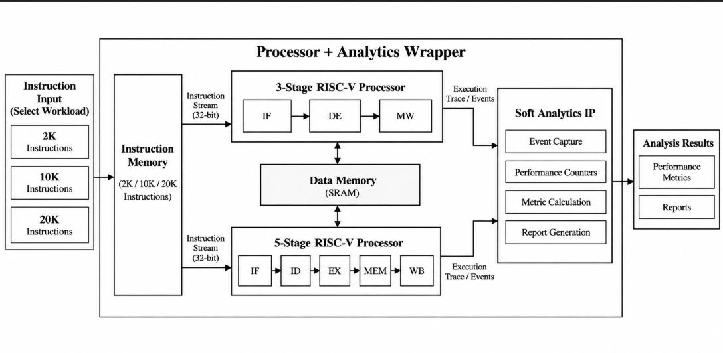
Block Diagram
9

Slide 10
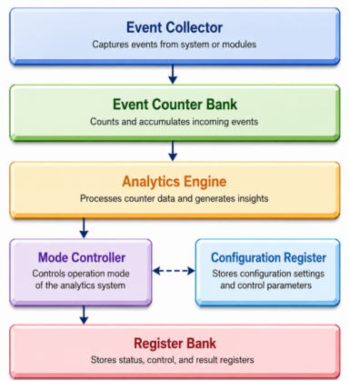
Analytic IP Architecture
  Event Collector: captures pipeline signals from the wrapper every cycle (retire, stall, flush, hazard, forwarding, memory, branch).
  Event Counter Bank: a dedicated counter for each event type accumulates the pulses.
  Analytics Engine: integer arithmetic turns counts into IPC, CPI, utilization, hazard distribution and forwarding efficiency.
  Mode Controller: selects Architectural or Microarchitectural mode and handles enable, reset and snapshots.
  Register Bank: memory-mapped store of counters and metrics; a Configuration Register adjusts parameters while the processor runs.
10

Slide 11
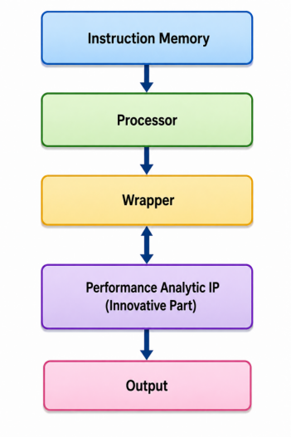
Methodology
  RTL design: 3-stage and 5-stage RISC-V cores in Verilog.
  Workloads: 2K and 10K instruction programs in instruction memory.
  Functional simulation: Xilinx Vivado Simulator (XSim).
  Data collection: instruction count, cycles, stalls and hazards.
  Soft Analytics IP: turns collected data into metrics and reports.
  Top-level wrapper: connects processor and IP.
  Integrated simulation: processor + wrapper + IP verified together.
  Scope: RTL simulation only; no physical hardware is built.
11

Slide 12
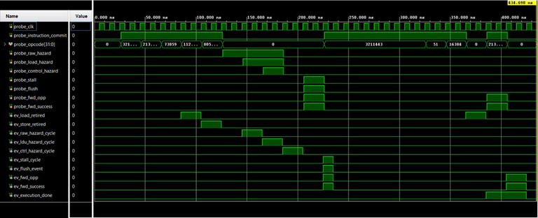
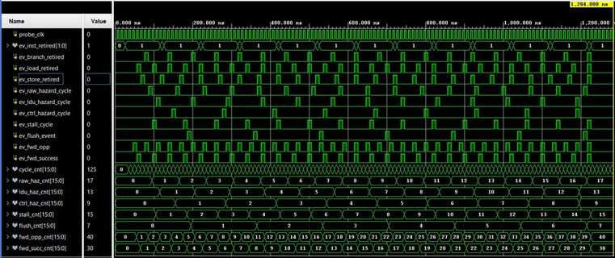
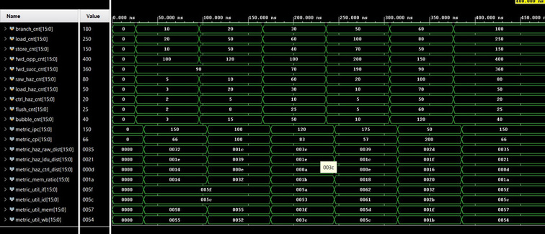
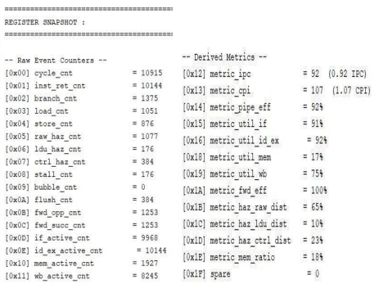
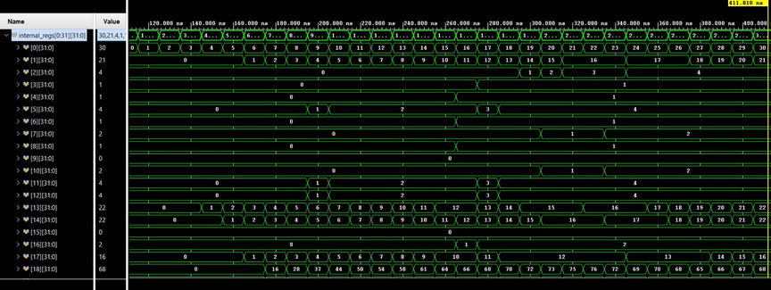
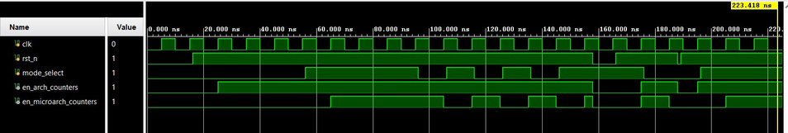
Simulation Waveforms
Event Collector
Event Counter
Analytics Engine
Mode Controller
Register Bank
12

Slide 13
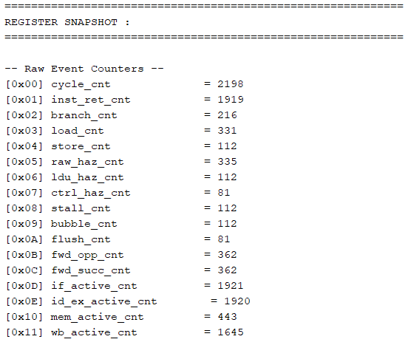
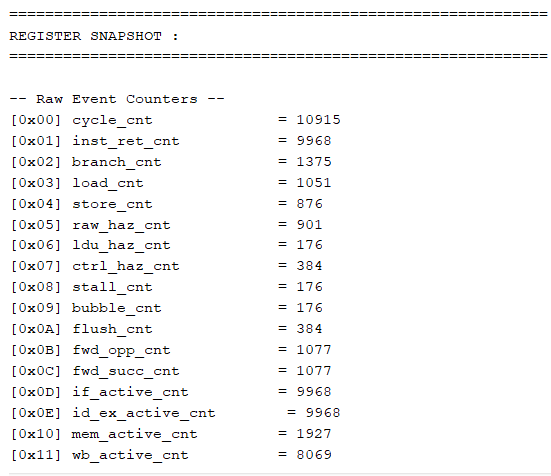
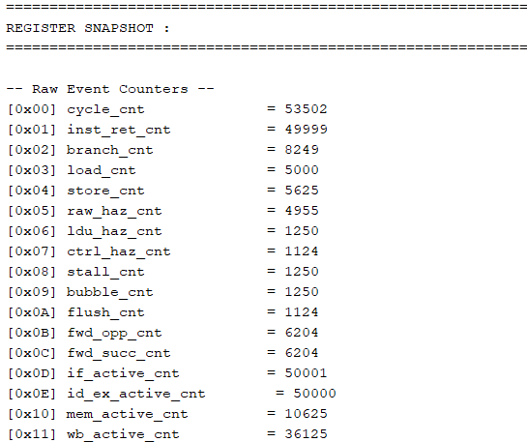
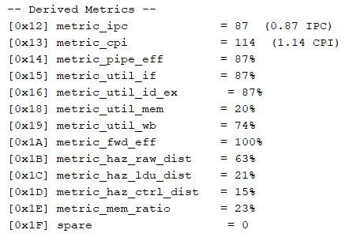
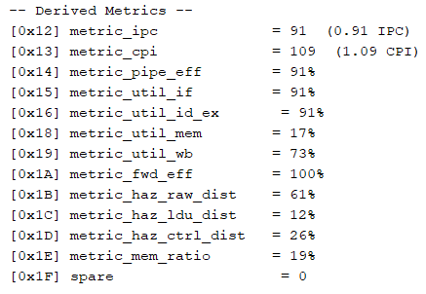
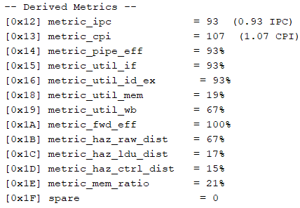
3 stage pipelining Processor
2k instructions
10k instructions
50k instructions

Slide 14
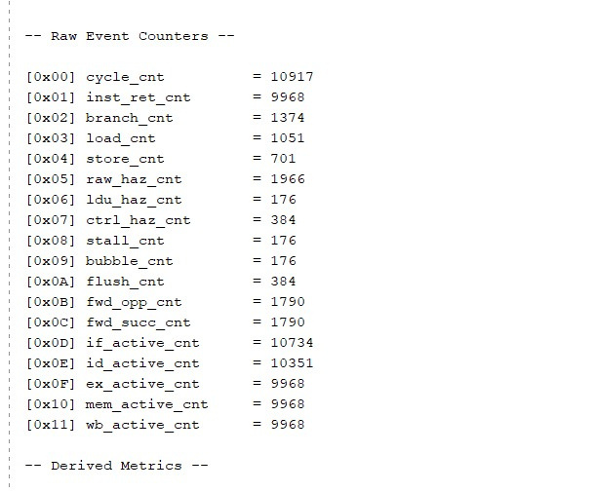
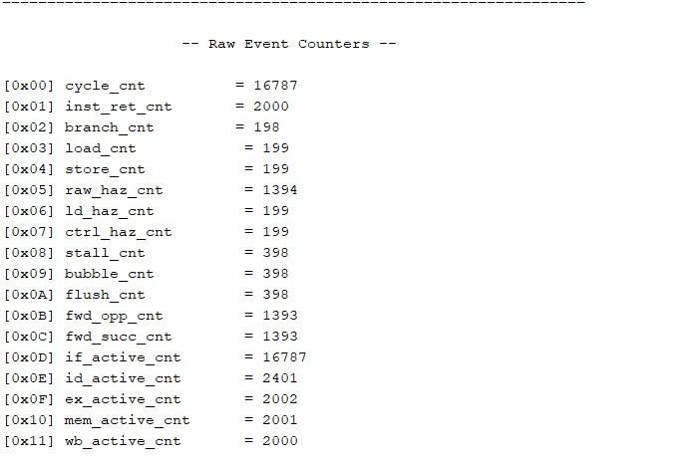
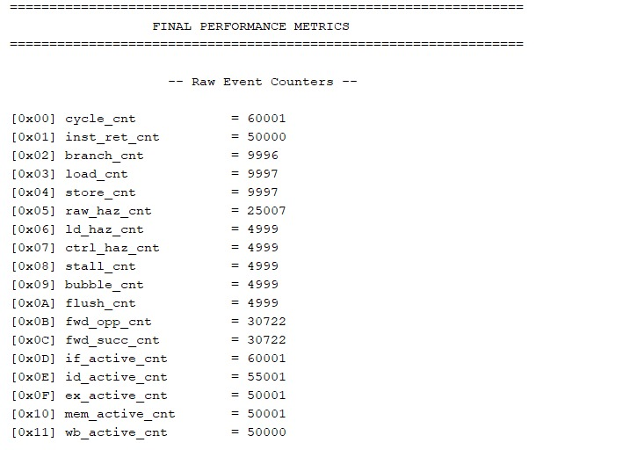
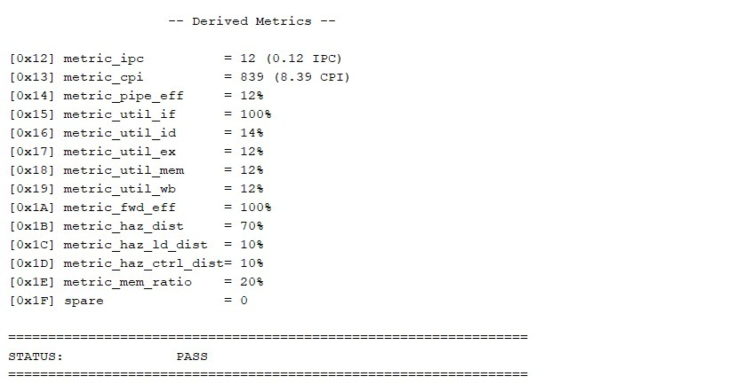
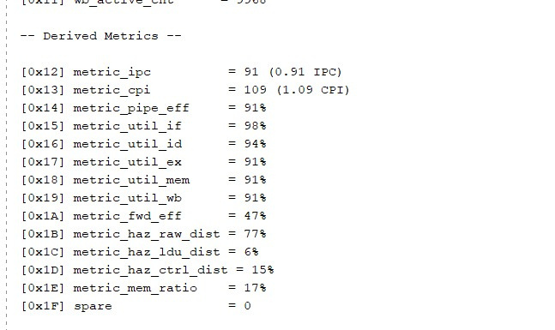
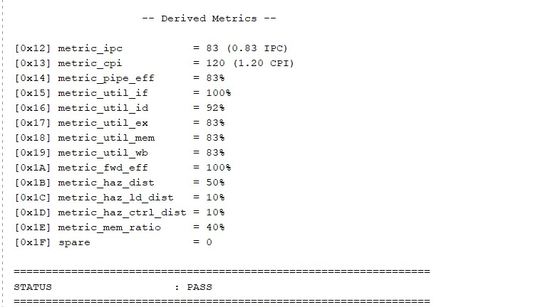
5 stage pipelining
2k instructions
10k instructions
50k instructions
14

Slide 15
Results and Discussion
Results:
  Analytics IP successfully captures raw events and calculates performance metrics for 2K, 10K and 50K instruction workloads.
  3-stage pipeline: IPC improves from 0.87 to 0.93, while CPI reduces from 1.14 to 1.07.
  5-stage pipeline: At 50K instructions, IPC is 0.83 and CPI is 1.20.
  Forwarding efficiency, hazard distribution and individual stage utilization are automatically reported.
Discussion – Insights Provided by Analytics IP:
  Performance tracking: IPC and CPI reveal how efficiently the processor executes different workloads.
  Bottleneck identification: RAW, load-use and control hazard distributions identify major sources of pipeline inefficiency.
  Pipeline analysis: Stage utilization reveals active and underutilized stages.
  Forwarding analysis: Compares forwarding opportunities with successful forwarding operations.
  Design optimization: Helps identify where hazard handling, forwarding and pipeline organization need improvement.
Key Outcome: Converts raw processor signals into measurable performance insights, reducing manual waveform inspection and additional analysis.
15

Slide 16
Advantages, Applications and Scope
Advantages
  Non-intrusive: thin wrapper, processor RTL unchanged.
  Reusable: only the wrapper signal mapping changes.
  Automatic IPC, CPI, hazard and utilization metrics.
  One bit switches the analysis mode at run time.
  Researchers take less time while evaluating performance
  Reduces the time for analysis
Applications
  Processor design and verification.
  Performance optimization: hazards and forwarding.
  Embedded and real-time systems.
  Architectural profiling and benchmarking.
FUTURE SCOPE
  Support more RISC-V processor architectures and pipeline configurations.
  Add more performance events and advanced analytics metrics..
  Improve measurement accuracy using higher-precision counters.
16

Slide 17
Conclusion
  A configurable Processor Analytics IP was designed in RTL to collect, count, and analyse architectural and microarchitectural events.
  Its five modules are integrated through a thin wrapper without modifying the processor's functional RTL.
  The IP was evaluated using 3-stage and 5-stage RISC-V pipeline configurations with 2K, 10K and 50K instruction workloads.
  It reports performance metrics such as IPC, CPI, pipeline efficiency, forwarding efficiency, stage utilization and hazard distribution.
  The proposed IP provides quick, script-free performance insights to support microarchitectural optimization ideas and can be reused across RISC-V processor cores.
17

Slide 18
References
  J. M. Domingos, T. Rocha, N. Neves, N. Roma, P. Tomas and L. Sousa, "Supporting RISC-V Performance Counters through Linux Performance Analysis Tools," in Proc. IEEE ASAP, 2023. https://doi.org/10.1109/ASAP57973.2023.00027
  S. Eyerman, L. Eeckhout, T. Karkhanis and J. E. Smith, "A top-down approach to architecting CPI component performance counters," IEEE Micro, vol. 27, no. 1, pp. 84-93, 2007. https://doi.org/10.1109/MM.2007.3
  N. Soares, T. Carvalho and L. M. Pinho, "Lightweight Performance Monitoring of Real-Time Applications in RISC-V Platforms," in Proc. Euromicro DSD, pp. 402-409, 2025.
  M. J. Arribas et al., "Design and implementation of a synchronous Hardware Performance Monitor for a RISC-V space-oriented processor," Microprocess. Microsyst., vol. 112, 105132, 2025. https://doi.org/10.1016/j.micpro.2024.105132
  E. Karabulut and A. Aysu, "Highly Reconfigurable Performance Monitoring Unit on RISC-V," in Proc. IEEE ICSICT, pp. 1-3, 2020. https://doi.org/10.1109/ICSICT49897.2020.9278263
18

Slide 19


19

